Slide 1
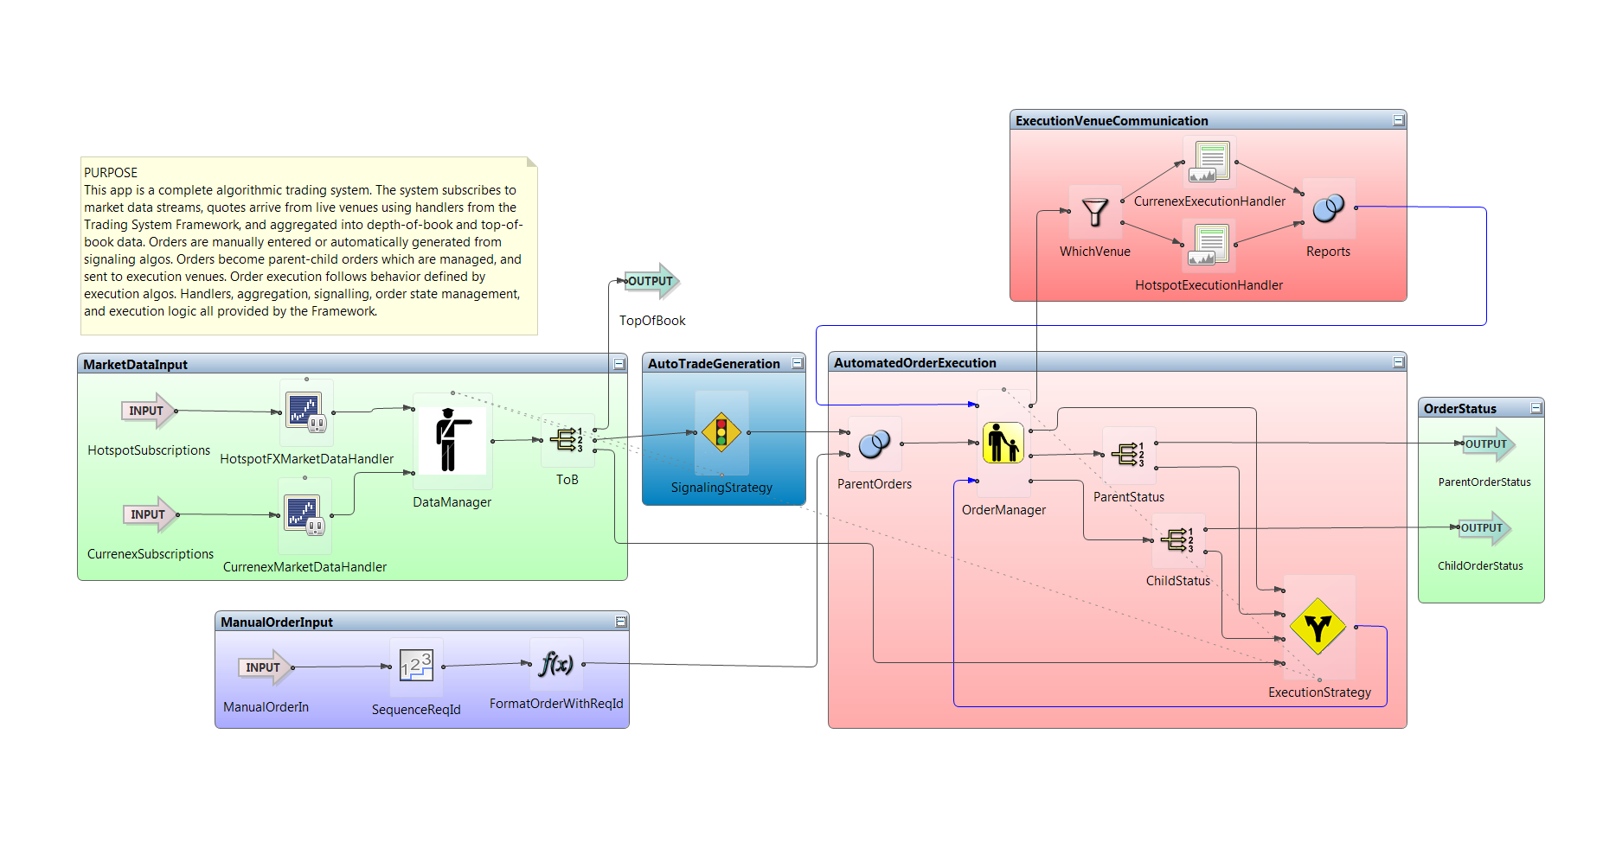


StreamBase EventFlow
Visual Programming for Complex Event Processing
Richard Tibbetts
CTO, StreamBase
OSCON, July 2011

Slide 2
StreamBase EventFlow
How many people have heard of CEP, Event Processing, Streambase?
Demo with StreamBase Studio
  Input streams, output streams
  State management
  Running applications
  Showing performance and latency
So, CEP is a great new way to build realtime data processing systems

Slide 3
EventFlow Diagrams

Slide 4
StreamBase EventFlow
What’s Complex Event Processing?
Where did StreamBase come from and why is it visual?
Learning from our experience:
  Lesson 1: Visual is great, but it starts out hard
  Lesson 2: Not every bit of visual has to be programming
  Lesson 3: Errors, errors, errors
  Lesson 4: Not every bit of programming has to be visual
  Lesson 5: Visual is great, and it ends up hard
Conclusion: Benefits of Visual Programming for Real Programmers

Slide 5
What is Complex Event Processing?
Static Data Processing: “What were the best performing stocks last week?”
Event Streams
time
1
2
3
4
5
6
7
8
9
Complex Event Processing: “When Microsoft moves 2% outside its 5-minute moving average, buy now.”
Execute
Notes:
Speaker: Richard

Slide 6
Complex Event Processing aka Event Processing
Software organized by events (compare object oriented)
  What’s an event? What’s an object?
  And event is something can trigger processing, can include data.
  Naturally but not usually represents a “real world” event or observation.
Complex Event Processing Platforms
  Software stack for event based systems, event driven architectures
  Event Programming Language – SQL-based, Rules-based, or State-based
  Commercial and open source: StreamBase, Progress, Microsoft, IBM, Oracle, SAP, Esper, Drools and many more
Adopted in financial services and other markets
  System monitoring, industrial process, logistics, defense/intelligence
Other Event Processing Approaches:
  Erlang, Actors, node.js, .NET Rx
Notes:
:06

Slide 7
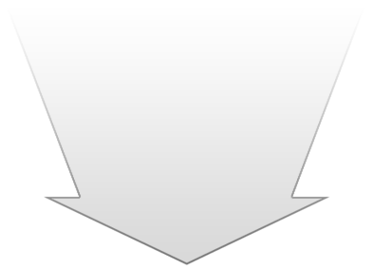
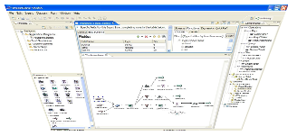
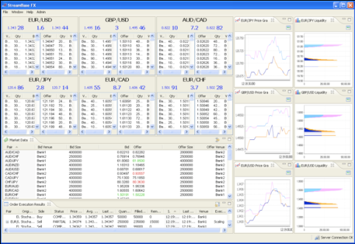
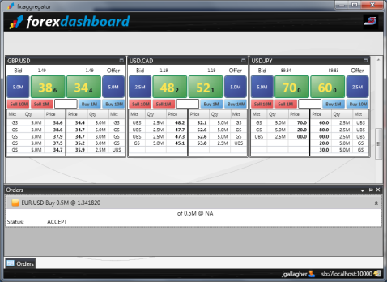

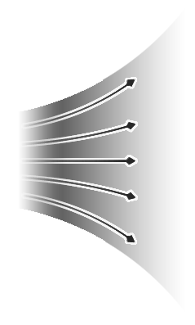


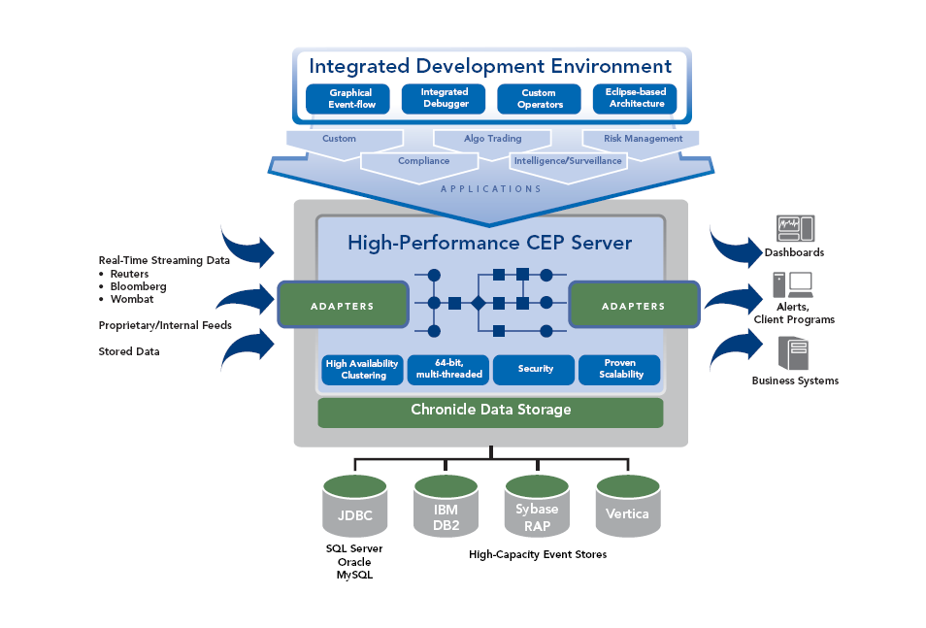


StreamBase Event Processing Platform
Studio Integrated Development Environment
StreamBase Developer Studio
Graphical StreamSQL for developing,
back testing and deploying applications.
Visualization
StreamBase Frameworks
StreamBase Component Exchange
Applications
Data Output
(publish)
OMS
Gateways
Venues
Messaging
Visualization
More….
Data Ingest
Market Data
Pricing
Orders
Files
Signals
Database queries
Adapters
StreamBase Server
Adapters
Data Management
Read and write to any database
Notes:
7
Page 7

Slide 8
StreamBase has been Visual from the Beginning
Mike Stonebraker always wanted to build a visual environment
The Aurora project

Slide 9
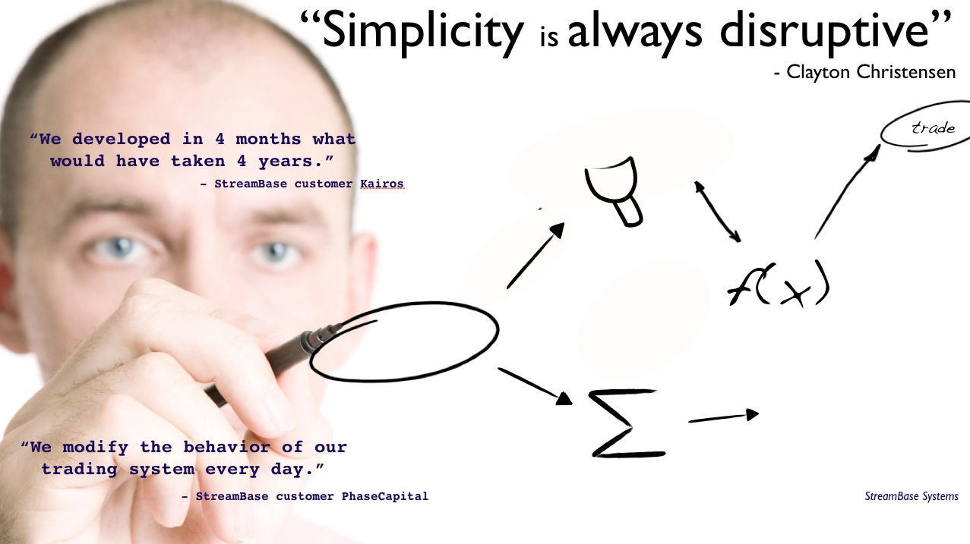
Why a Visual Domain-Specific programming Language
High level
Graphical
Appropriate for purpose
Understandable
Flexible
Notes:
:08

Slide 10
Visual Programming for Real Programmers
Target audience is not end users or non-experts
Generally people who could do it in C++ or low level Java/.NET if they wanted to
So don’t hold back on functionality
But do deliver on the usability and discoverability people expect from visual languages

Slide 11
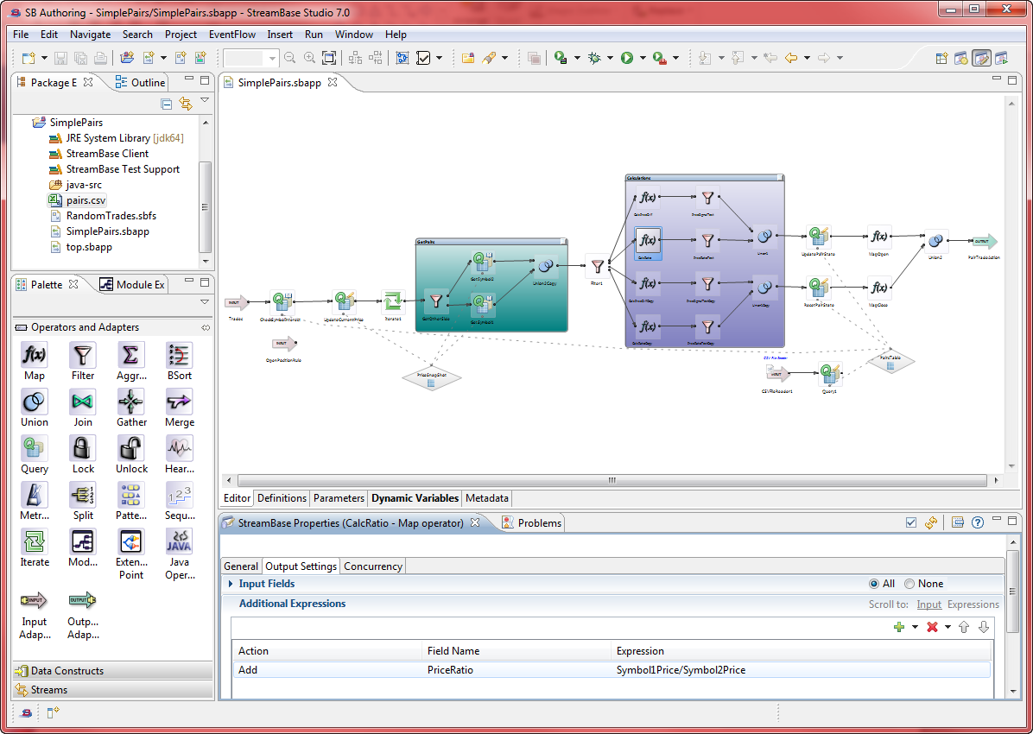
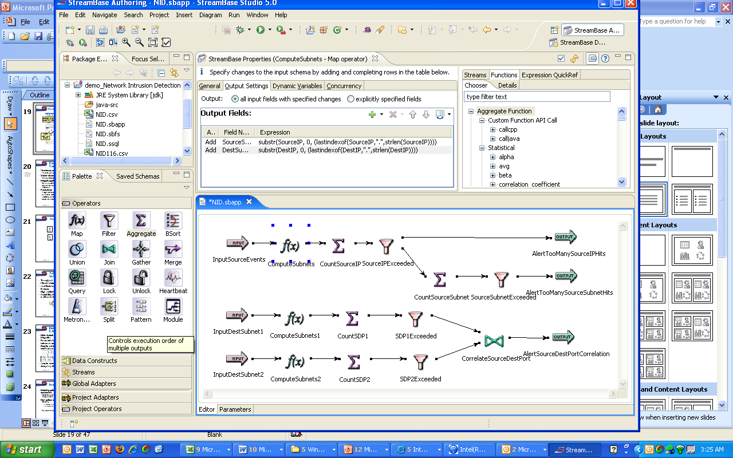
StreamBase Development Studio Today
Projects & Resources
Development Canvas
Configurable Properties
Operator Palette
Notes:
EDDIE BUILDS APP STARTING HERE (BUILDS)
11

Slide 12
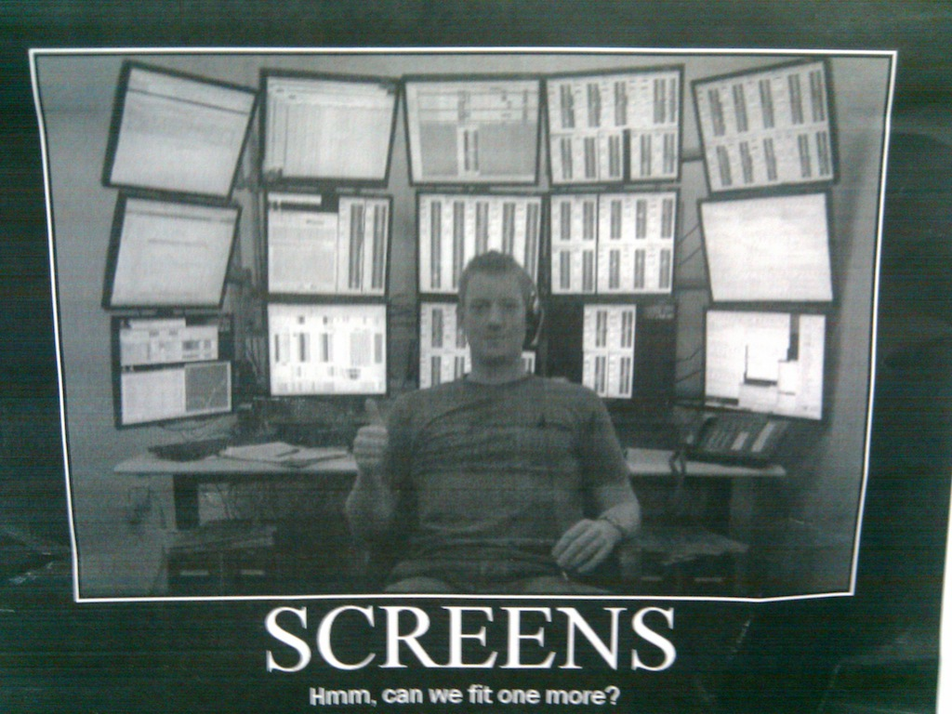
How did we get there
From here:
To here:
While these guys:
Imagined this:

Slide 13
Lesson 1: Visual is great, but it starts out hard
Building an IDE
Defining your visual model
Making it easy to build simple things quickly

Slide 14
Building an IDE
The IDE is going to be as important as your runtime and language
Build on a platform (Eclipse, maybe something else)
Do as little as possible, leverage the platform, leave things out
  The platform is going to keep getting better, so delaying reduces work
  Early adopters are forgiving if you get the core right.

Slide 15
Defining your visual model
You’ve never had a syntactic holy war until you’ve had a syntactic holy war about icons
Benefits of being based on a visual paradigm with some history
  Existing terminology
  Example “applications” you can draw from
  Existing icons
  Easier for some developers to learn, but only if they know your paradigm
A manageable piece of a visual model has 30-40 items in it, so information density must be relatively high
  StreamBase applications before good modularity ran to 600 items.
  Now they run to several thousand.

Slide 16
Get your serialization format right
Serialization format is not to be taken lightly
  We did XML, but it our schema too verbose and fragile in places
Chicken-and-egg choices when developing features mean you will hand coding a lot of apps until IDE support is there for what you build.
Until you build diff/merge support, and whenever you have bugs, developers are going to deal with your serialization
  Especially for backwards compatibility

Slide 17
Making it easy to build simple things quickly
Wherever possible, let people quickly hack things together, so their initial experience is positive
  Useful defaults for newly instantiated components
  Avoid modal dialogs, required questions
Support both mouse and keyboard
  Keyboard accelerators only used by a fraction of developers, and generally only for initial application construction
If you get the information density and right, coding speed should not be bottlenecked on graph construction
  Except that it will always be for demos and trivial apps

Slide 18
Lesson 2:
Not every bit of visual has to be programming
Non-semantic information is important
Modules versus Groups
Parallel Regions versus Parallel Items

Slide 19
Non-Semantic Information is Important
Text languages have non-semantic information
  Whitespace, comments, variable names
Visual languages do too, possibly even more
  Graphical layout of applications, colors, sizes of things, in addition to above
Opinion: Layout is an important way to convey understanding
Opinion: Any application too large for auto-layout needs modules

Slide 20
Modules versus Groups
Group
Module
Module in a Group

Slide 21
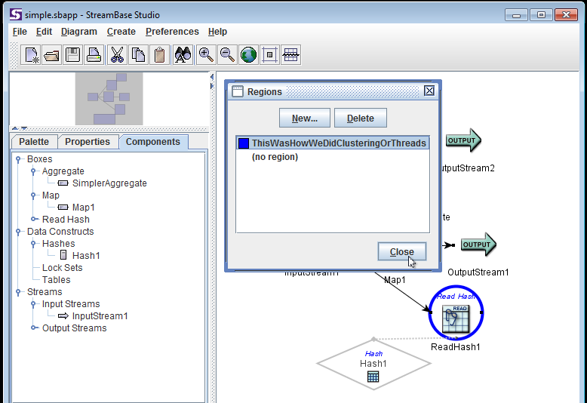
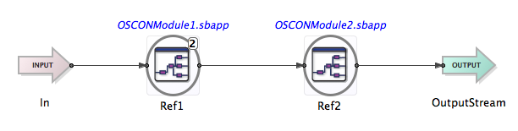
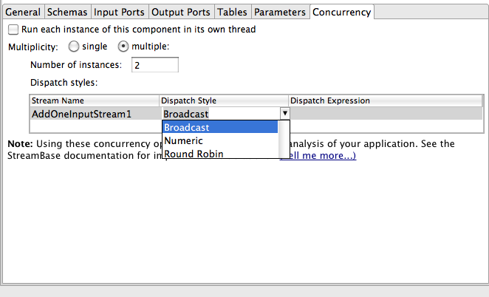
Parallel Regions versus Parallel Items
Color determines synchronization
Modularity determines synchronization

Slide 22
Lesson 3:
Errors, Errors, Errors
Good Errors
Located Errors
Capture Fields

Slide 23
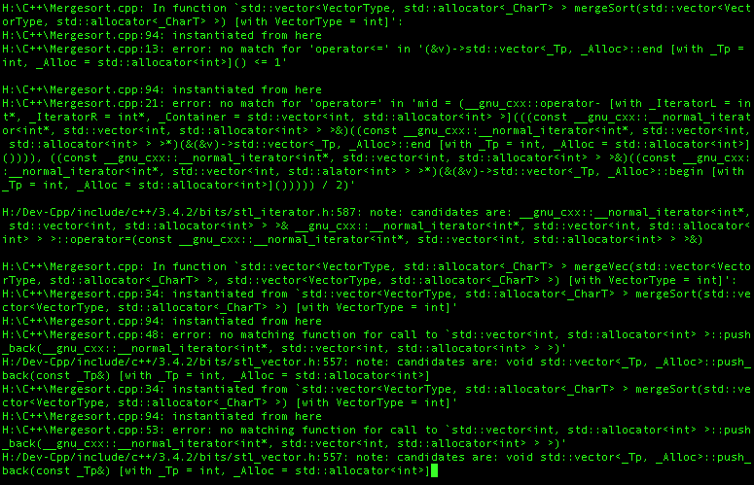
Bad Errors
Notes:
C++ Errors

Slide 24
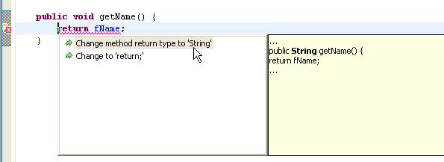
Good Errors
Notes:
Java Eclipse IDE error and Quickfix

Slide 25
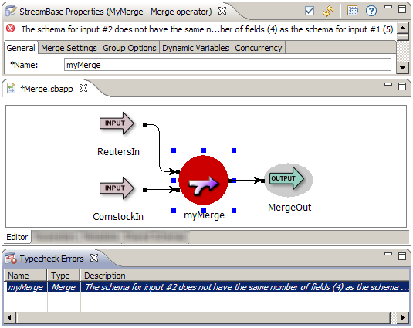
Good Errors

Slide 26


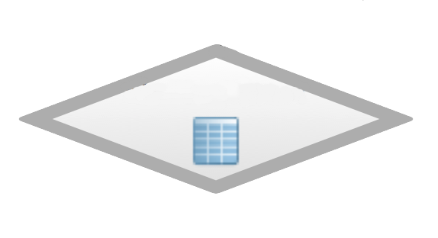
Capture Fields – Change the language to improve errors
Polymorphic modules were previously macro-style substitution
Strongly typed parameters for template-style polymorphism reduce flexibility, enable call-site friendly errors
Typing is done at the edges, instead of in the middle
@T= population
points w/ pop
points w/ capt
points w/ capt
points w/ pop
points w/ capt
Capture Fields: Modularity in a Stream-Relational Event Processing Language
Naomi Seyfer, Richard Tibbetts and Nathaniel Mishkin. DEBS 2011

Slide 27
Lesson 4:
Not every bit of programming has to be visual
SSQL text language
Interfaces, event dispatch, parallelism, extension points
Easy stuff and key info is still visible

Slide 28
StreamSQL Text Language
In version 3.7 we introduced a textual, SQL-style dialect of the StreamSQL language
Adoption by developers has been limited to a few areas
  Embedding queries in other languages, code generation
99% of developers still write exclusively in EventFlow
But there has been significant value for the development team
  Faster prototyping of new features
  Easier testing
Would recommend a textual dialect, but tricky to keep it from limiting adoption of your visual dialect.

Slide 29
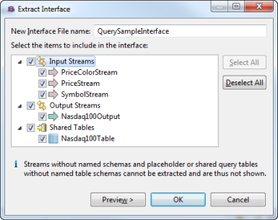
Interfaces
Interfaces are non-visual, edited through properties panes
Often created by refactorings

Slide 30


Event Dispatch and Parallelism

Slide 31
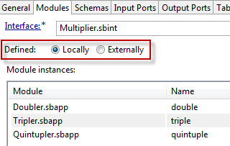
Extension Points
Referenced applications are defined on a tab, or externally in configuration files

Slide 32
Keep key info for application understanding visible
How to decide what to keep visible?
  Application correctness and dependencies are visible
  Important non-visible stuff gets badges
Code review and auditing is important
  Tooltips on canvas items show all operator information
  Diff tools help, align canvas with diff of serialized code

Slide 33
Lesson 5: Visual is great, and it ends up hard
If you succeed, people are going to expect a full IDE
Backwards compatibility, Debuggers, Diff/Merge, Document Generators

Slide 34
People are going to expect a full IDE
If you’re successful, people will want everything, perfect
  Debuggers, Diff/merge
  Documentation management
  Refactoring support, and more refactoring supportx
  Commenting out code
  Forward and backward compat
  Unit testing frameworks, Dependency injection frameworks
  Framework frameworks
In many cases choosing the right IDE platform helps a lot
Luckily if you get here you are successful and have help

Slide 35
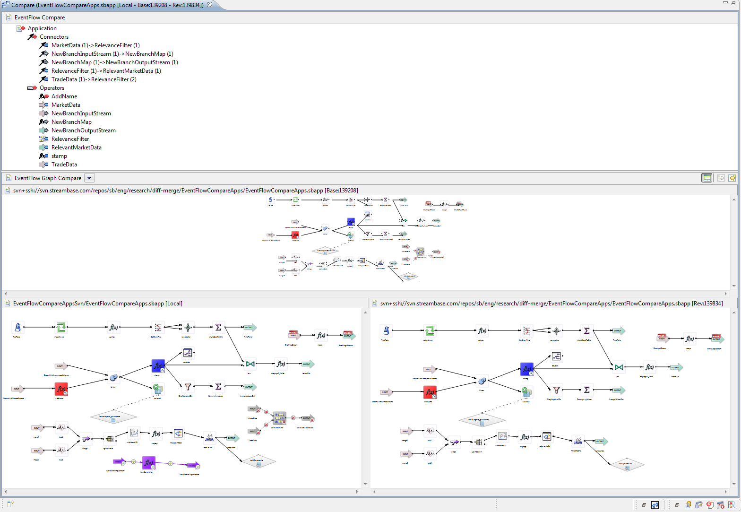
Diff/Merge

Slide 36
Benefits of a visual language
The future of visual languages
Heterogeneous teams
Match the whiteboard
Natural interaction with compiler

Slide 37
Big Win for Visual – Heterogeneous teams
The traditional separation between “business” and “IT” is eroding – this is a good thing
People who run the business have technical backgrounds and want to stay in the loop
Continuum of people interacting with EventFlow apps
  Hardcore system software developers
  Enterprise IT developers
  Quantitative analysts
  Business experts
  End users and business leadership
All of them on the same project, all of them in the code.

Slide 38
Big Win for Visual – Matching the Mental Model
What does your language align to?
  The hardware/machine model
  A compromise in the interest of software engineering (Object Oriented)
  The mental model of the solution
Aligning to the mental model of the solution is good for the programmer and great for the compiler
  Fewer design patterns means faster code
  Doesn’t have to be visual, can apply to non-visual DSLs
Of course, there is always room for improvement in impedance match between the problem domain, the language, and the execution environment.

Slide 39
Shameless Plugs
StreamBase
  Download and try it out: http:/www.streambase.com
  Build something and submit to the StreamBase Component Exchange
    http://sbx.streambase.com
  We’re hiring and we’re training
    http://www.streambase.com/developers-training-events.htm
DEBS – Distributed Event Based Systems
  Academic (ACM) Conference, July 16-20, 2012 in Berlin
    http://www.csw.inf.fu-berlin.de/debs2012/
EPTS – Event Processing Technology Society
  http://ep-ts.org industry consortium
Questions?
Notes:
:48

Slide 40
Questions?
Download StreamBase and More Information
http://www.streambase.com

